Slide 1
Customer Clustering with K-Means Using K-Means Algorithm in E-commerce
KAMALI S(2575776)
DAY-9

Slide 2
AGENDA
Data Exploration
Data Preprocessing
Implementing K-Means
Model Training
Customer Clustering
Real-World Application
Model Limitations

Slide 3
Data Exploration
Understanding the Data: Data exploration helps us gain a comprehensive understanding of the dataset.
Quality Assessment: We can identify data quality issues, including missing values, outliers, and inconsistencies.
Pattern Discovery: By visualizing the data and creating summary statistics, we can discover patterns, trends, and anomalies.
Feature Selection: Data exploration guides us in selecting the most relevant features for our analysis.
Data Preparation: Exploratory analysis aids in data preprocessing by guiding decisions on how to handle missing data, normalize features, and address other data-related challenges.

Slide 4
Data Preprocessing
Data Quality Enhancement
Standardization
Noise Reduction
Data preprocessing is a vital step that ensures our dataset is clean, well-structured, and ready for the clustering algorithm. This process lays the foundation for meaningful insights and accurate customer clustering

Slide 5
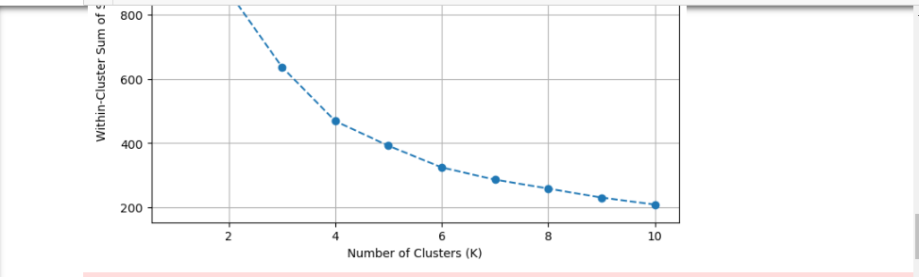
Implementing K-Means
K-Means is an unsupervised machine learning algorithm used for clustering data.
It groups data points into 'K' clusters, where 'K' is a user-defined number.

Slide 6
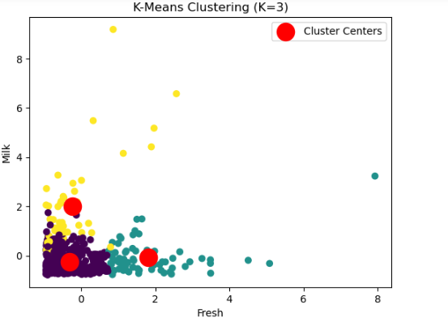
Model Training
1. Choosing the Number of Clusters (K)
2. Initialization of Cluster Centers
3. Iterative Assignment of Data Points
4. Recalculating Cluster Centers
5. Convergence
6. Result Interpretation
.
7. Validation and Fine-Tuning

Slide 7
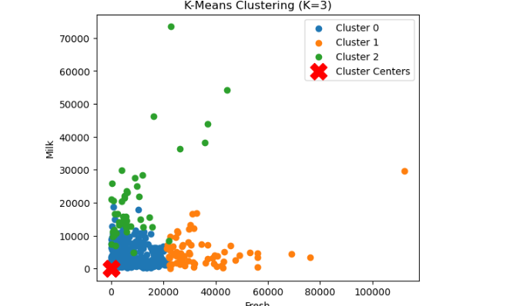
Customer Clustering
we calculate their similarity or distance to each cluster center.
After clustering, we analyze and interpret the characteristics of each cluster.
Clustering is not a one-time effort; it's an iterative process.

Slide 8
Real-World Application
Personalized Marketing:
Inventory Management:
Pricing Strategies:
Customer Support:
Product Development:
Customer Lifetime Value (CLV) Prediction:
A/B Testing and Experimentation:

Slide 9
Model Limitations
K-Means can produce different results based on the initial cluster center placement.
Suboptimal initializations may lead to subpar clustering outcomes.
K-Means assumes that clusters are spherical and equally sized.
In cases where clusters have complex shapes or vary significantly in size, K-Means may struggle to capture the structure effectively.
Data preprocessing becomes crucial to address these issues.

Slide 10
THANKYOU

